Slide 1
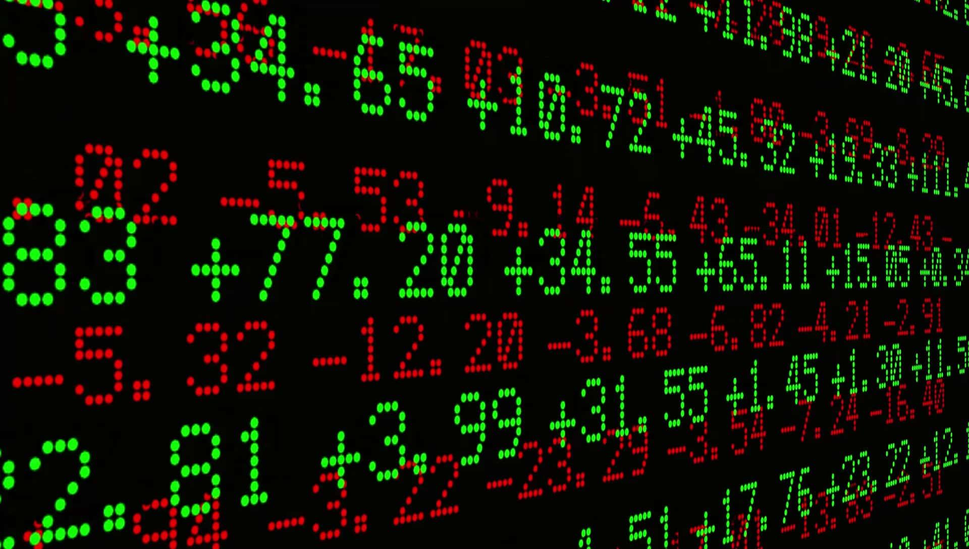

Stock Tweet
Group Members
Bhavani Kumar, Divya Harikumar,
Kara Wenz, Rory Lukins

Slide 2
Inspiration/Goals for Project
Social media is changing the way the world is interacting/communicating with each other. Companies are also influenced by the use of social media
To this end, we wanted to see if we could predict the movement of the stocks based on the sentiments of the stakeholders (company, users, investors, media, analysts).
We wanted to track the sentiments of what a company was tweeting and what was being tweeted about/at them.
We compared the sentiment analysis to hourly stock prices to see if there was any correlation.
If there is correlation, we thought it might be possible to predict stock activity!
We took a company from each market capitalization structure to study the influence of social analytics on their stock price movement.

Slide 3
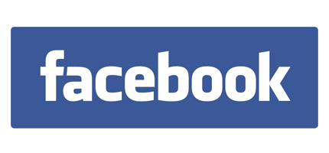


Inspiration/Goals for Project
We decided to focus on the tech industry because it seems to depend heavily on branding and user sentiment.
We chose Facebook for large-cap Stock, Nintendo for a mid-cap stock and MindBodyOnline for a small-cap stock.

Slide 4
Data Collection
We first started to collect tweets from Facebook, tweets directed to Facebook, tweets with #facebook.
As we were doing our research, we came across “cashtags”. They are similar to a regular hashtags, but specific to stock tickers. So we included them in our tweet gathering.
After getting all the tweets and graphing the data, we compared it to a graph of the stock activity for the day (from Yahoo Finance) and the stock performance over a period of time.
Then we selected a mid cap company (Nintendo) and a small cap company (MINDBODY), and gathered the same information.
Because there are such a vast amount of tweets and we only had so much time, we only grabbed data for three days for Facebook and two days for the other company.
With more time (and more efficient code) we would have a better idea of what the data is saying and how to apply that to stock prices.

Slide 5
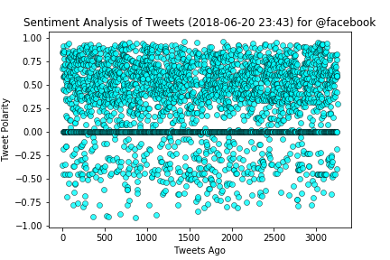
‘@facebook’ tweet analysis
User: @facebook Compound: 0.612 Positive: 0.227 Neutral: 0.773 Negative: 0.000

Slide 6
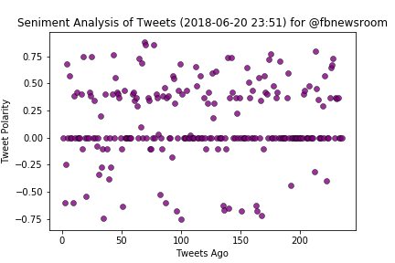
‘@fbnewsroom’ tweet analysis
User: @fbnewsroom Compound: 0.000 Positive: 0.000 Neutral: 1.000 Negative: 0.000

Slide 7
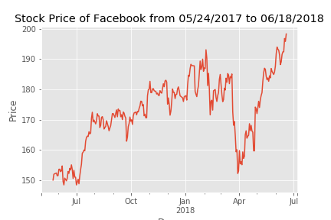
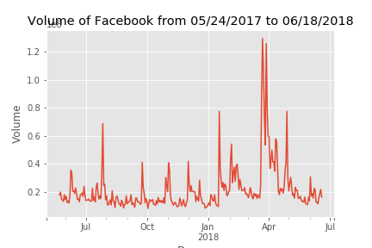
Analysis of Facebook Stock

Slide 8
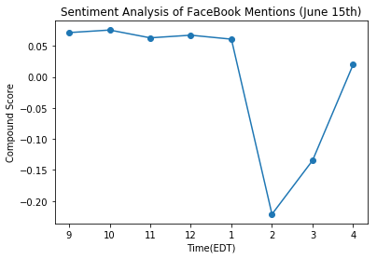
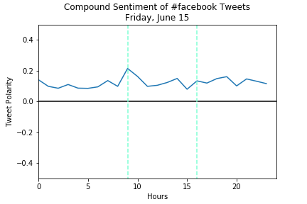
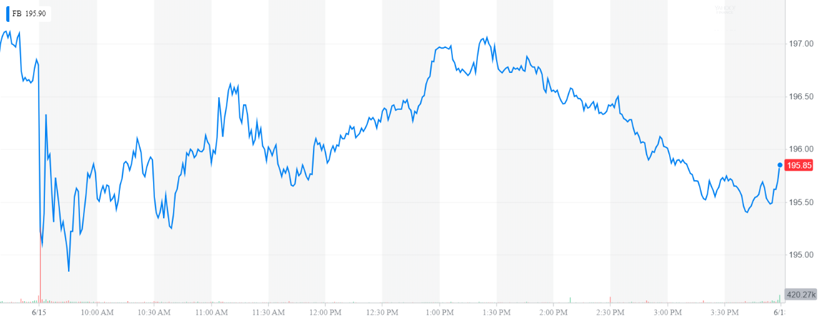
Analysis of Facebook (Friday, June 15)

Slide 9
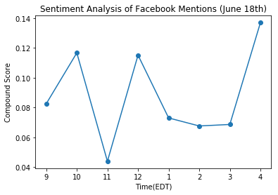
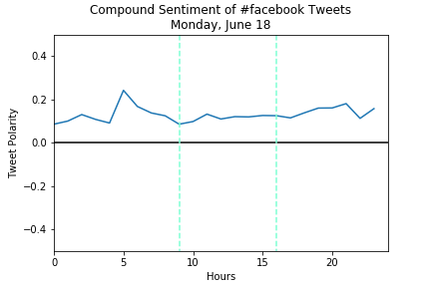
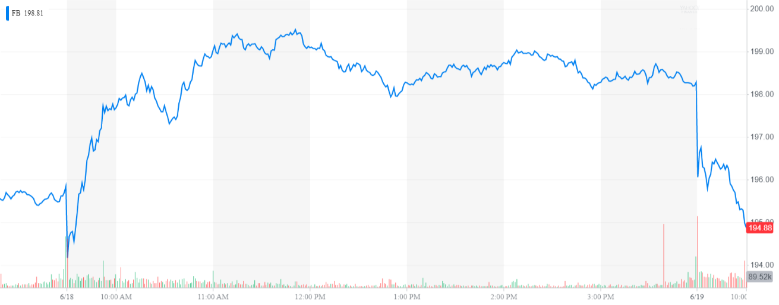
Analysis of Facebook (Monday, June 18)

Slide 10
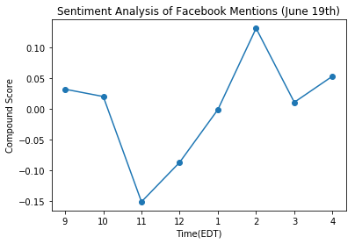
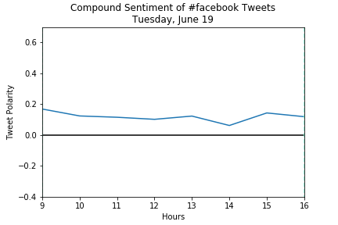
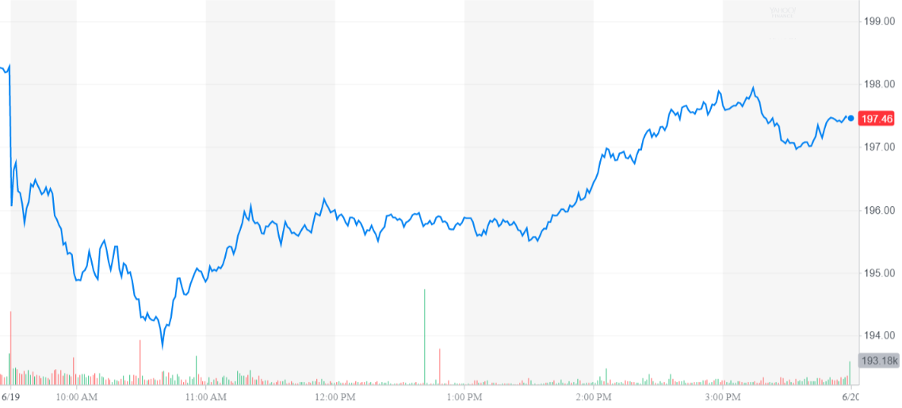
Analysis of Facebook (Tuesday, June 19)

Slide 11
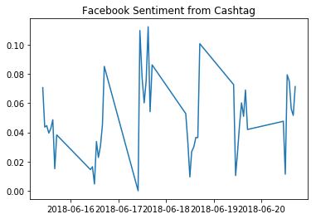
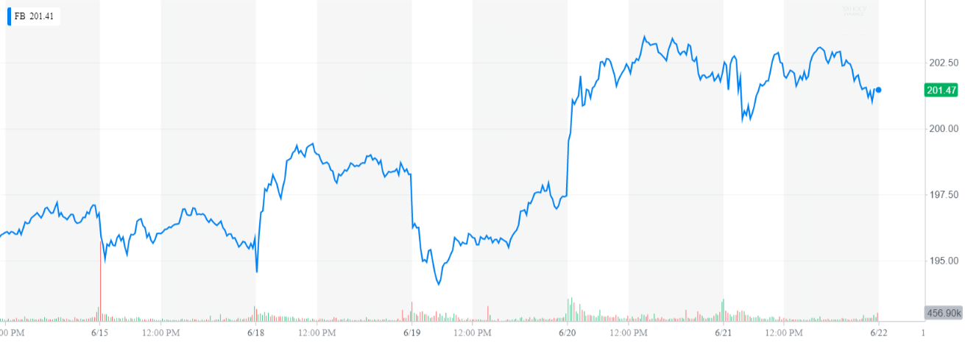
Analysis of Facebook from Cash Tag
(June 15-20)
Notes:
Analysis from June 15th through June 20th

Slide 12
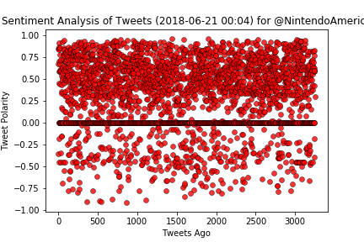
‘@NintendoAmerica’ Tweet Analysis
User: NintendoAmerica Compound: 0.296 Positive: 0.109 Neutral: 0.891 Negative: 0.000

Slide 13
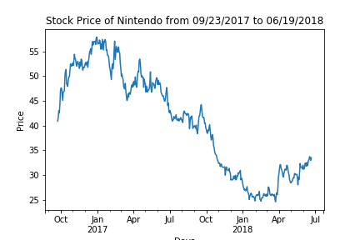
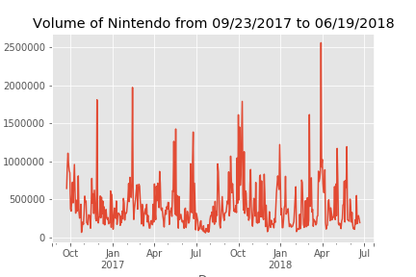
Analysis of Nintendo Stock

Slide 14
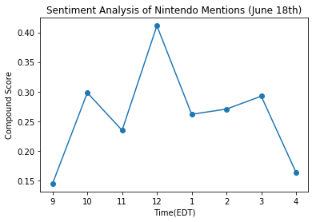
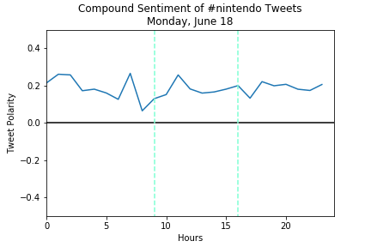
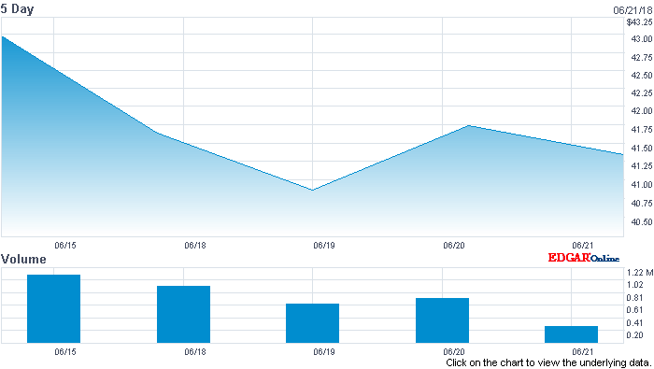
Analysis of Nintendo (Monday, June 18)
Source: Nasdaq

Slide 15
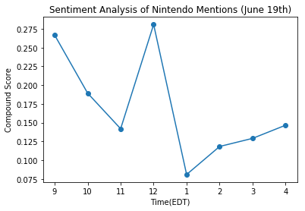
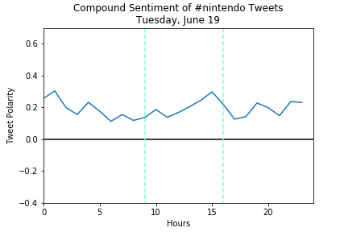
Analysis of Nintendo (Tuesday, June 19)
Source: Nasdaq

Slide 16
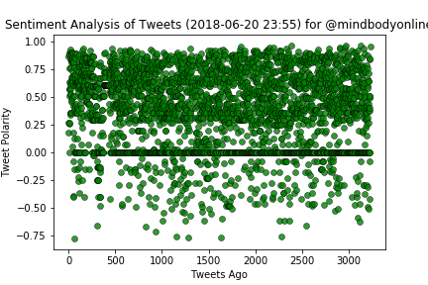
‘@mindbodyonline’ tweets analysis
User: @mindbodyonline Compound: 0.959 Positive: 0.577 Neutral: 0.423 Negative: 0.000

Slide 17
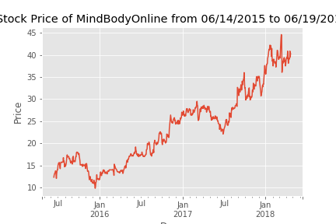
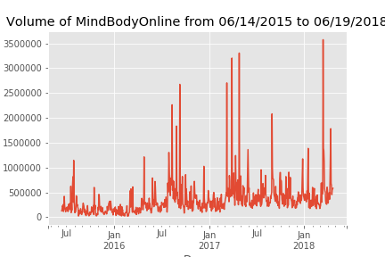
Analysis of mindbodyonline Stock

Slide 18
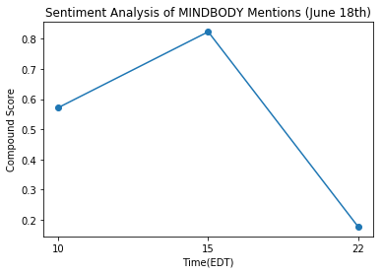
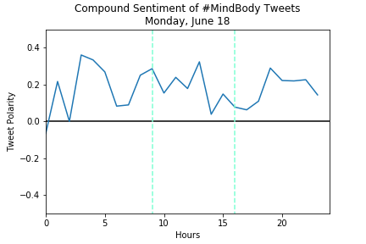
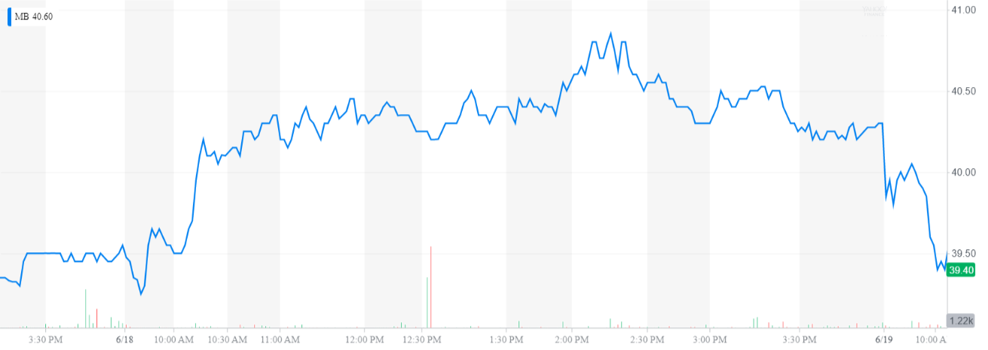
Analysis of MINDBODY (Monday, June 18)

Slide 19
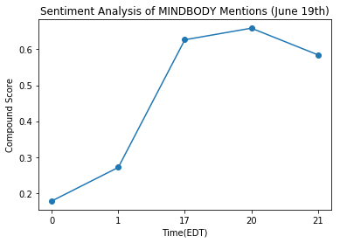
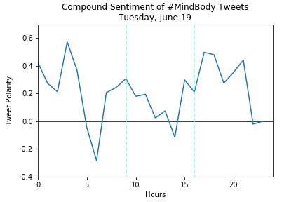
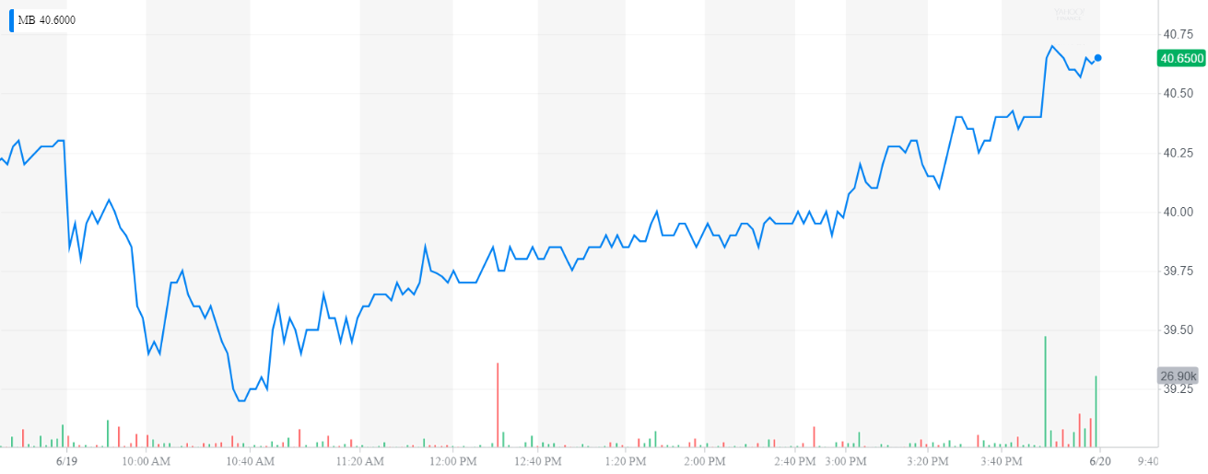
Analysis of MINDBODY (Tuesday, June 19)

Slide 20
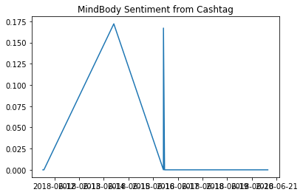
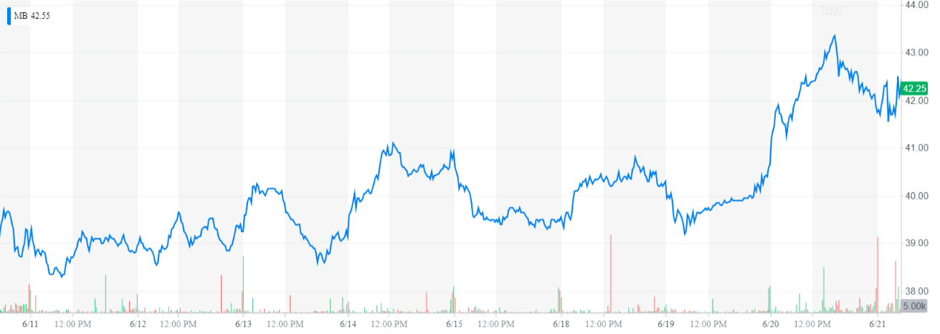
Analysis of MindBody from Cashtag
(June 11-20)
Notes:
Analysis from June 11 th through June 20th

Slide 21
What we learned...
On some of the days, public sentiment did loosely correlate with intraday movements in the stock price, which suggests that there is potential in social analytics to gain some insight into intraday stock performance.
Many more variables would need to be included in any predictive model that considers social analytics.
For example, second-by-second trading and minute-by-minute stock prices would be very useful, but this data is very expensive.

